Slide 2
Upcoming District Projects
Community Board # 8 Presentation

Slide 3
Agenda
  Jeffrey A. Laufer, Corporate Affairs Manager, BX Regional & Community Affairs
    Gas Main Replacement Work
    Upcoming NYC Department of Design & Construction Project

Slide 4
Upcoming Gas Main Replacement Work
Anticipated completion Feb/March 2026
Post Road between Faraday Ave and W. 256 Street
Post Road between Mosholu Ave and Faraday Ave

Slide 5
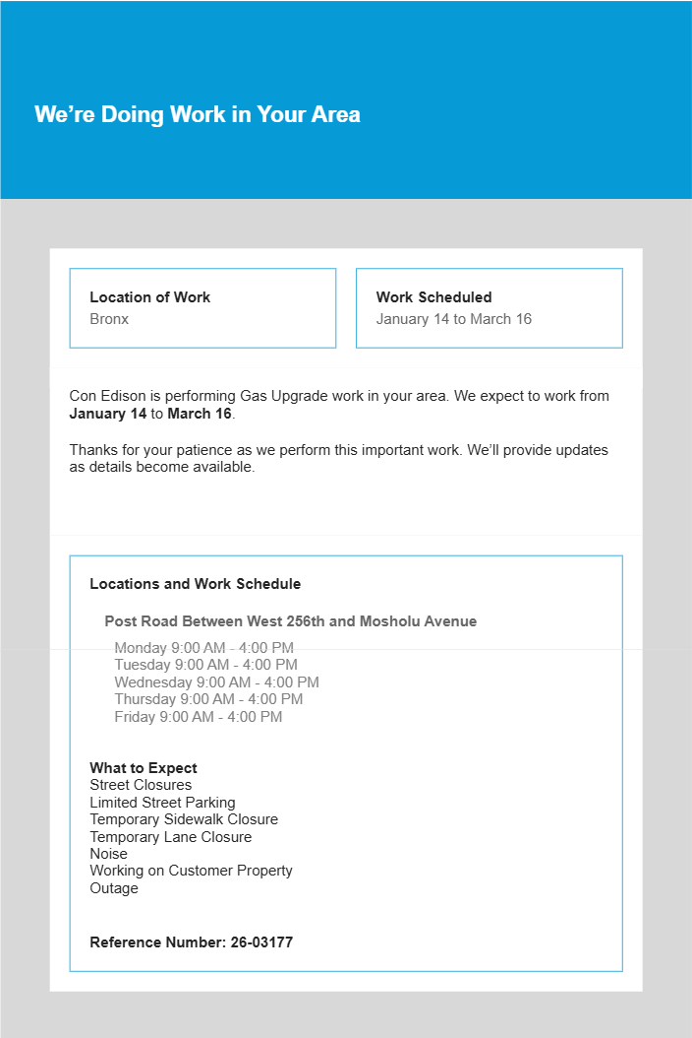

Work Notification

Slide 6
Upcoming NYC Department of Design & Construction Project
DDC has requested that Con Edison relocate poles in advance of their upcoming Northwest Bronx School Safety Improvement project (HWX406).
Con Edison’s Public Improvement Department will coordinate closely with DDC to meet their project needs.
DDC anticipates start of construction in the Summer 2027
Any Con Edison relocation work will be directly tied to DDC's timelines.

Slide 7
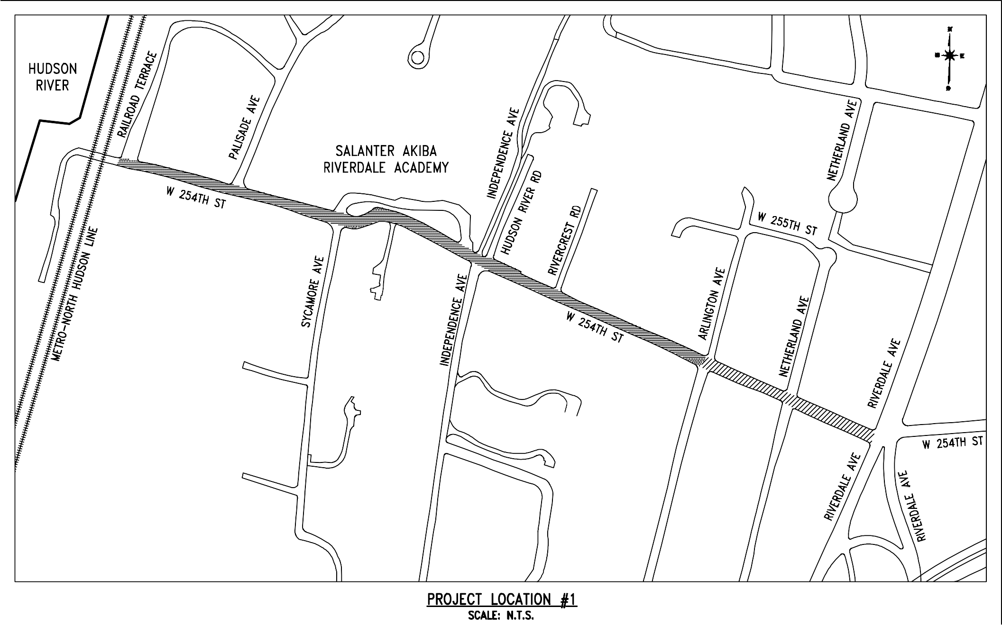
W 254 ST BETWEEN RAILROAD TERRACE & RIVERDALE AVE
DISTANCE: 2500 FT (7 BLOCKS)
NUMBER OF POLES: 25

Slide 8
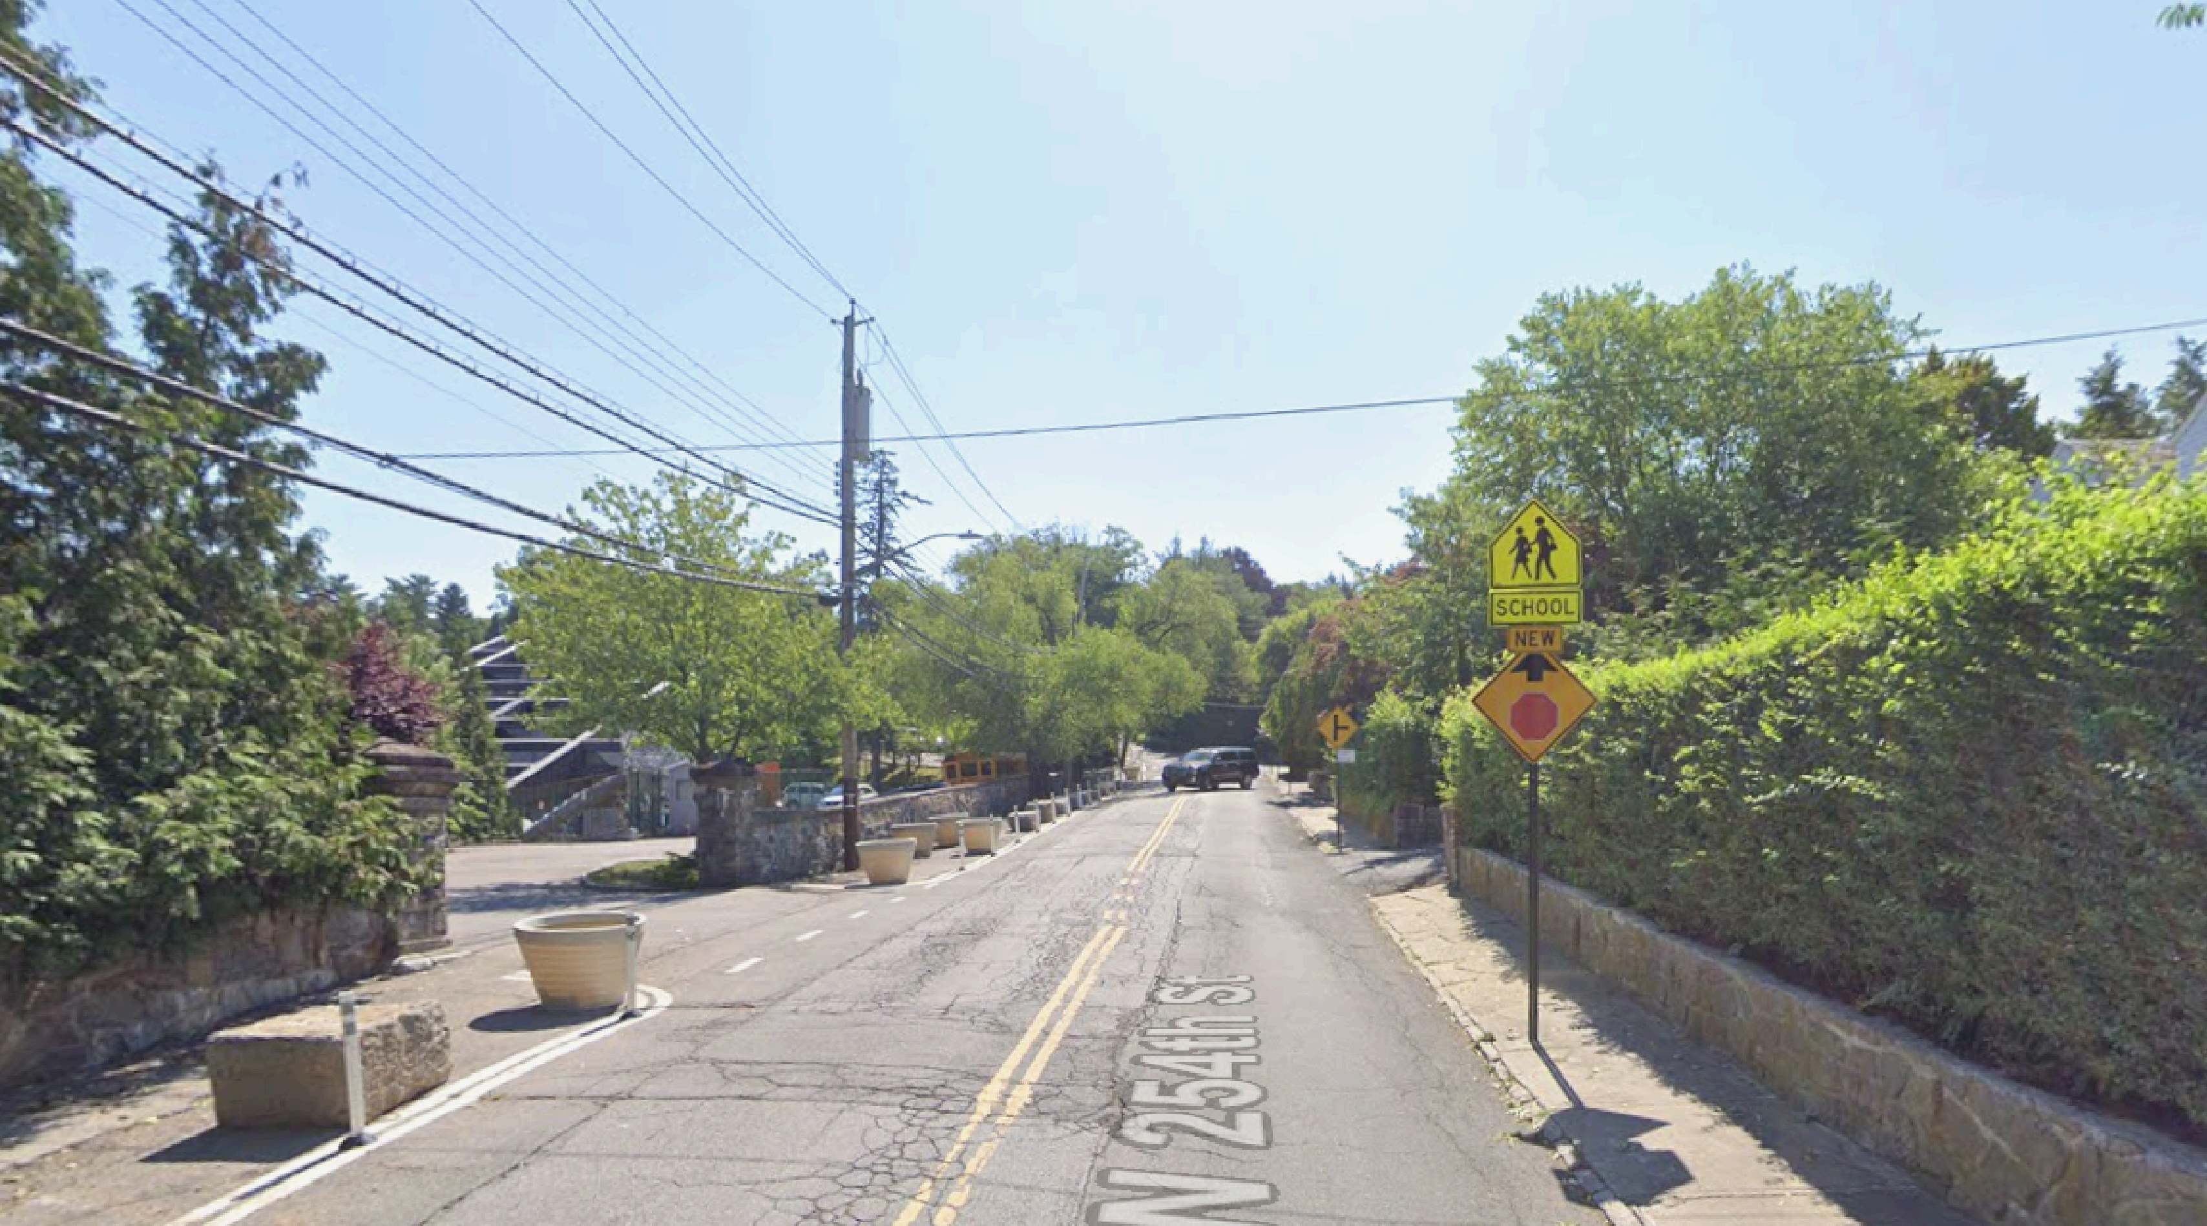

Slide 9
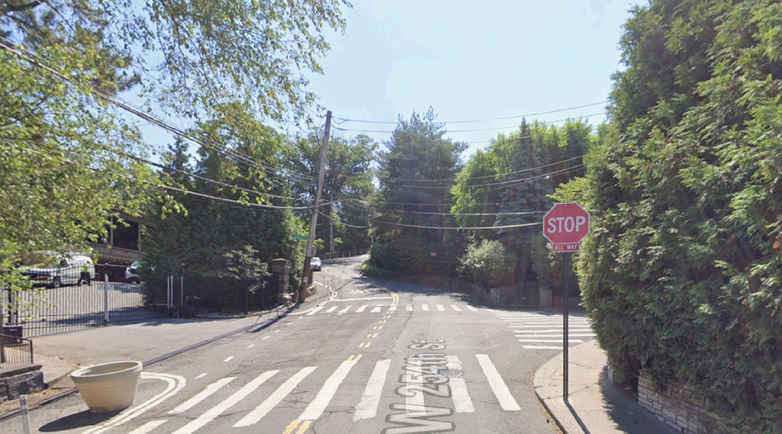

Slide 10

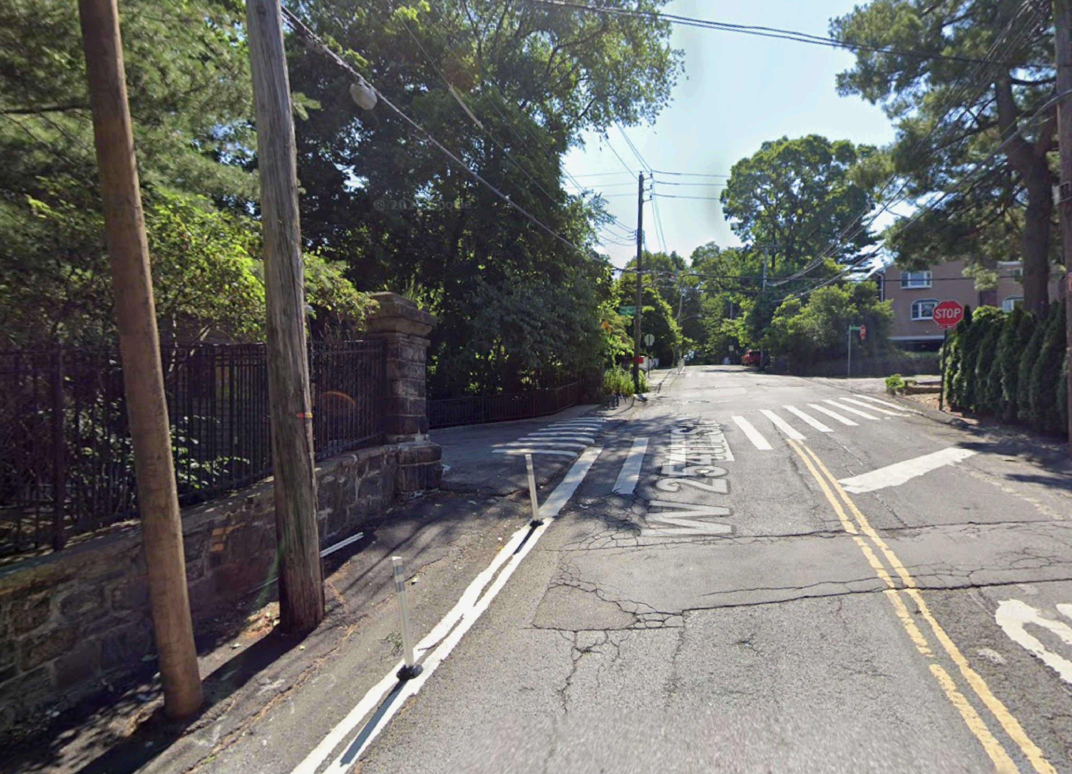

Slide 11
Questions?
Contact Information:
Jeffrey Laufer
Corporate Affairs Manager
Bronx Regional & Community Affairs
E-Mails - LauferJ@Coned.com BronxRCA@coned.com

