Slide 1
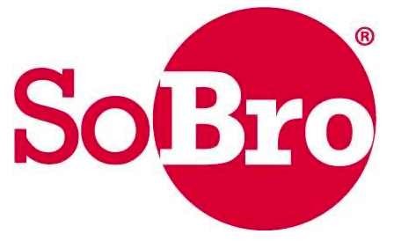
Obtaining NYC and NYS MWBE Certification

Slide 2
Legal Foundation for the
NYC and NYS MWBE Program
New York State
New York City
New York State Article 15a - contract goals are designed to provide MWBEs with “opportunity for maximum feasible participation in the performance of statement contracts.”
All state contracts, unless expressly excluded by statue, are subject to MWBE goals setting; including, but not limited to, commodities procurements, contractions, professional services, contracts, loans, grants and leases of real property.
As a matter of public policy, Governor Cuomo established a MWBE goal of 30% on State contracts. That goal applies to all State contracts greater than $25,000 in commodities and $100,000 in construction.
Every contract solicitation must clearly state its the MWBE goals.
Every state contract must identify the MWBE goals and contain enforcement language.
New York City Local Law 1 of 2013 was signed to strengthen the existing M/WBE program.
Since Local Law 1 (formerly Local Law 129 of 2005) was signed, the New York City Department of Small Business Services has been implementing improvements to the M/WBE program to promote fairness and equality in the City’s procurement process.

Slide 3
M/WBE Engagement in NYC and NYS
The M/WBE Program has tripled Citywide M/WBE contracting in four years. More than 9,000 businesses currently benefit from New York City certification, and the City remains committed to:
awarding $25 billion in City contracts to M/WBEs by the end of Fiscal Year 2025
awarding 30 percent of the value of City contracts to M/WBEs by the end of Fiscal Year 2021.
New York State
New York City
The M/WBE utilization rate for New York State's Minority- and Women-Owned Business Enterprises on state contracts increased to 29.51 percent during the 2019-20 Fiscal Year - representing $3.14 billion in contracts - the highest rate in the nation.

Slide 4
Benefits of M/WBE Certification
New York City
New York State
Vendor service representatives to assist with the procurement process
Receive expert advice and assistance on bids and proposals
Attend Business development classes on City contracting
Events to help firms build relationships with City agencies and large contractors
Other benefits of certification include access to networking events, customized courses and targeted consultations.
Online Directory of Certified Businesses: http://mtprawvwsbswtp1-1.nyc.gov/
Listed on the NYS Directory of certified firms.
Access to MWBE procurement and/or contracting opportunities with NYS Agencies and Authorities.
Access to lending and bonding programs exclusively for certified MWBEs.
Receive customized alerts for upcoming procurement opportunities. (NYS Contract Reporter).
Access to statewide network of services and invitations for business development workshops, webinars, classes and customized technical assistance.

Slide 5
Discretionary Buying Threshold
This procurement method allows agencies to contract with certified M/WBEs without a formal procurement process.
Three bids are still required for purchasing, but there is no requirement that a bid offering be placed in the open market. Instead, the procuring agency can secure bids directly from MWBE-certified firms.
The procurement threshold for NYC and NYS is $500,000
Additional NYS restrictions:
The Discretionary Buying Threshold for commodities, services, and technology not available from Preferred Sources or from the OGS Centralized Contracts, is $50,000 for State agencies; $85,000 for OGS Agency-Specific Contracts; and $125,000 for SUNY.
Purchases of commodities that are food, including milk and milk products, grown, produced or harvested in New York state is up $200,000.

Slide 6
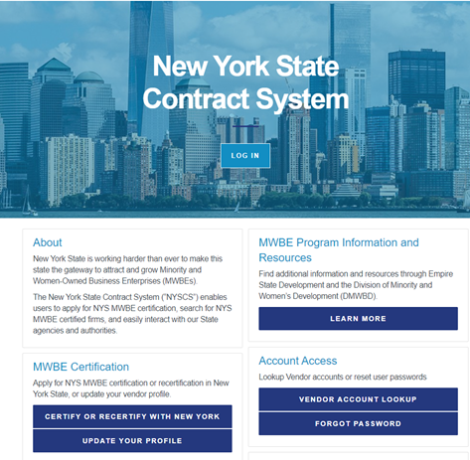
Create an account and click:
‘Apply for MWBE Certification’
NYC MWBE
NYS MWBE
https://sbsconnect.nyc.gov/
https://ny.newnycontracts.com

Slide 7
Document Checklist – for NYC and NYS
Resume for each owner.
Bank letters.
Business federal, state, and city signed tax returns for the most recent tax year, including all schedules.
Proof of U.S. citizenship or permanent resident alien status for each owner.
Licenses and permits which the business holds.
Lease agreements or proof of ownership for all business locations, which must be valid for at least six months after the date of application.
Business contracts and invoices completed and signed, for services performed by the business, within the past year, along with proof of payment.
Proof of minority group status of each owner claiming minority status.
Business start details demonstrating how the business was initially capitalized.
Businesses incorporated outside of New York State must produce a Certificate of Authority from the NYS Secretary of State.

Slide 8
MWBE Certification Application: Requirements
To qualify for certification under the M/WBE program for NYC and NYS, a company must:
Be in business for at least one year.
Be 51% independently owned, operated, and controlled by a woman and/or a member of a recognized minority group, including Asian American, African American, or Hispanic American, Native American.
North Africans, European (Spanish or Portuguese) ethnicities are not considered Hispanic for MWBE certification and are ineligible for certification.
Franchisees controlled by the franchisor are ineligible for certification, however, minority-owned franchisors are eligible.
Eligible owner(s) must direct and control day-to-day operations of the company.

Slide 9
MWBE Certification Application: Requirements (cont.)
Additional NYC MWBE Requirements:
Must be located within the geographic market-New York City or one of the following surrounding counties: NY: Nassau, Putnam, Rockland, Suffolk, Westchester. NJ: Bergen, Hudson, Passaic.
If the company is located outside of New York City and in the counties listed above, it must have a substantial presence in the City's business community (e.g., derived 25% or more of gross receipts from business conducted in the City, possess a license issued by the City, have a bank account in the City.)
Additional NYS MWBE Requirements:
Owners who own more than 10 percent of the business must provide a Personal Financial Statement not exceeding $15 million in assets
Lease Agreement: must submit up to six (6) months proof of lease payments
Must submit current personal and business tax information
An LLC must submit Certificate of LLC Publication
Ethnicity Attestation Affidavit
MWBE Certification for both NYC and NYS last five (5) years.

Slide 10
Business Services Programs at SoBro
SoBro PTAC - helps businesses to obtain government certifications and with bid proposal reviews.
Industrial Business Zone Program - connects business owners with resources needed to start, operate and grow their businesses utilizing New York City Department of Small Business Services tools and resources.
SoBro MBDA Center - provides services in the following areas: Access to Capital; Access to Contracts, Access to Markets, and Global Business Development Services.
SoBro Entrepreneurship Center - provides business assistance to new and aspiring entrepreneurs by providing resources to take them from conception to launch.

Slide 11
Contact the SoBro Team
Robbin Finney-Granston
Senior Vice President
rgranston@sobro.org
Evangeline Gelladola
Program Director, PTAC
egelladola@sobro.org
Andrew Hyman
Assistant Director, PTAC
ahyman@sobro.org
Mary Olushoga
Business Specialist, PTAC
molushoga@sobro.org

